Slide 1


DBIDS Visitor Enrollment System (DVES)
Visitor Pre-enrollment General Public Edition
Pass and Registration

Slide 2
Base Entry Pre-enrollment
Individuals or groups requiring installation access now have the ability to pre-register using the DBIDS Pre-Enrollment Website from any smart device prior to proceeding to a visitor center to initiate a visit pass request.
Pre-Enrollment significantly reduces the amount of time a Defender spends entering identity data into the DBIDS system. The DVES concept was created using this Pre-Enrollment functionality combined with the following steps from the visitor and sponsor
Completion of the pre-enrollment via any smart device
Submission of QR/Alpha numeric code, copy of driver’s license and visit dates to the VCC via org box 9SFS.VCC.RegistrationRequest@us.af.mil.
Identity proofing and vetting is still accomplished manually by Security Forces personnel (CVIA/Pass and Registration)
After a satisfactory background check is complete, Pass and Registration will email sponsor that their guest has been approved and may proceed the installation gate for issuance of the visitors pass.

Slide 3
Process Steps
VISITOR | SPONSOR | VISITOR CENTER | Gate Arrival
Complete DBIDS Pre-Enrollment | Provide below visit information to Base VCC via email | Receive sponsor and visitor information via email | Visitor provides Drivers License to Defender and informs of pre-enrollment
Provide below visit information to Sponsor via email | Sponsorship information (DOD ID # Needed ) | Conduct Background Check via NCIC | Defender verifies profile has been created/vetted for fitness via profile
QR/Alpha numeric code from pre-enrollment | Visitor QR/Alpha Numeric Code | Create DBIDS profile by scanning QR/Alpha numeric code | Visitor has updated photo and fingerprints inputted into DBIDS computer
Scanned/Photo copy of Driver’s License | Scanned/Photo copy of visitor’s Driver’s License | Take photo of Driver’s License picture for biometric | Visitor pass created
Visit Dates | Visit Dates

Slide 4
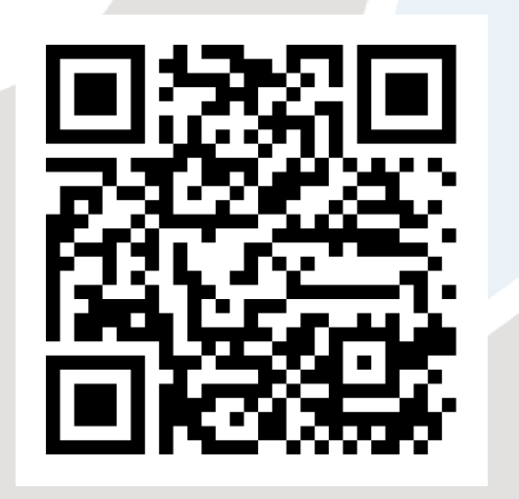
Pre-enrollment Link
Link: https://dbids-global-enroll.dmdc.mil/preenrollui/#!/
Click the link or scan this QR Code for quick access

Slide 5
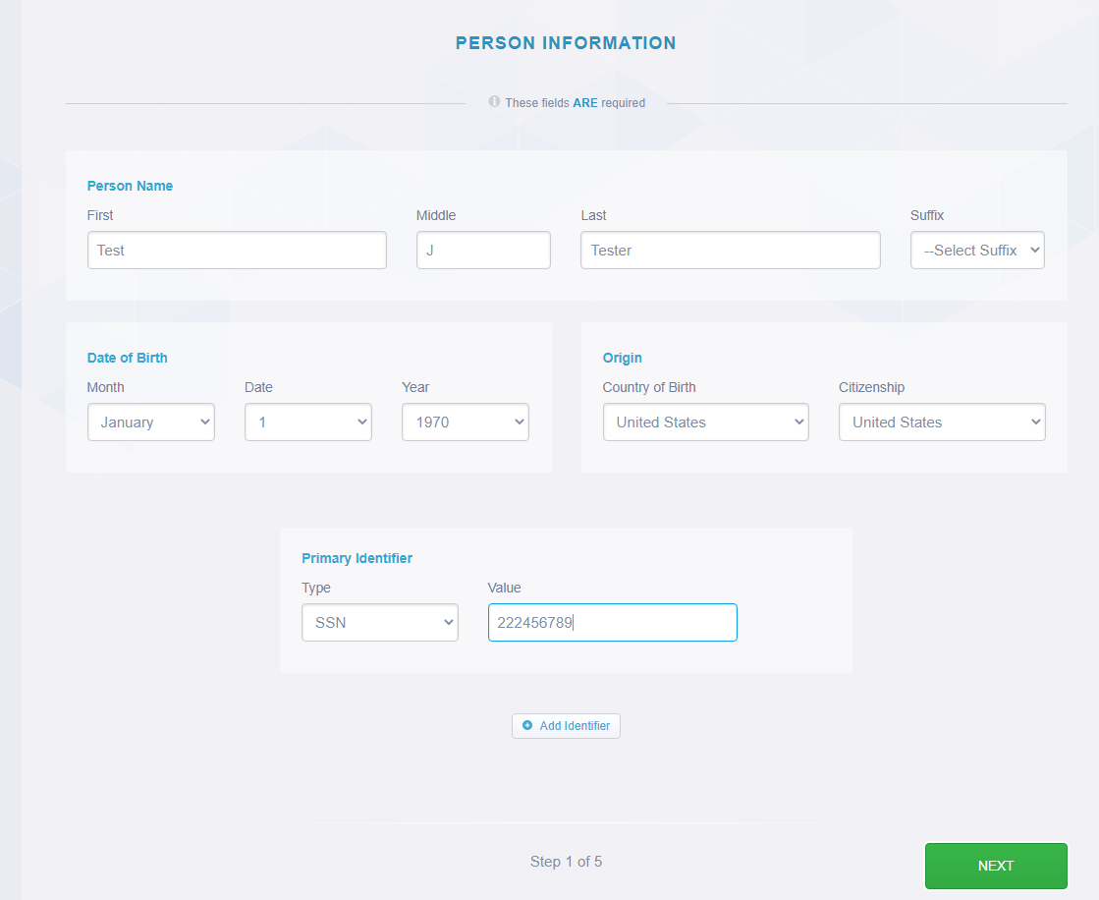
How to Pre-enroll
Once on DBIDS site the tab will populate.
Note: if nothing populates your page will have to be refreshed.
The first tab will be the personal information tab. Please ensure this is filled out completely utilizing the SSN as the identifier.

Slide 6
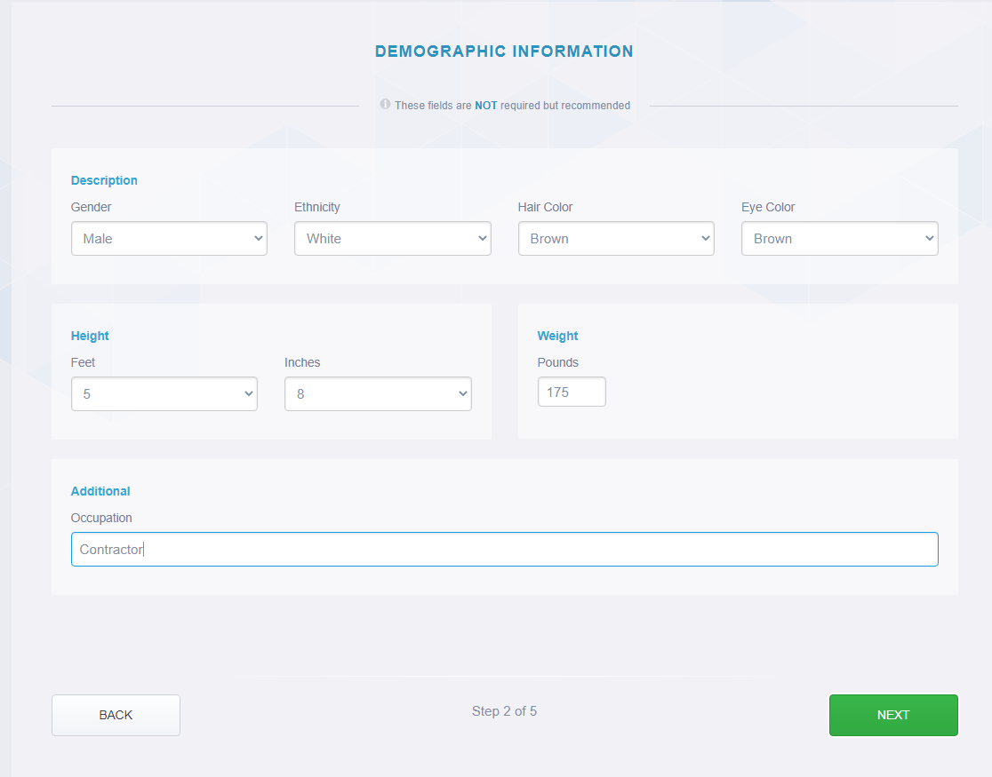
Pre-enrollment step 2
This information is used as identifying information used to confirm the identity of the visitor. Please ensure it is filled out completely and accurately

Slide 7
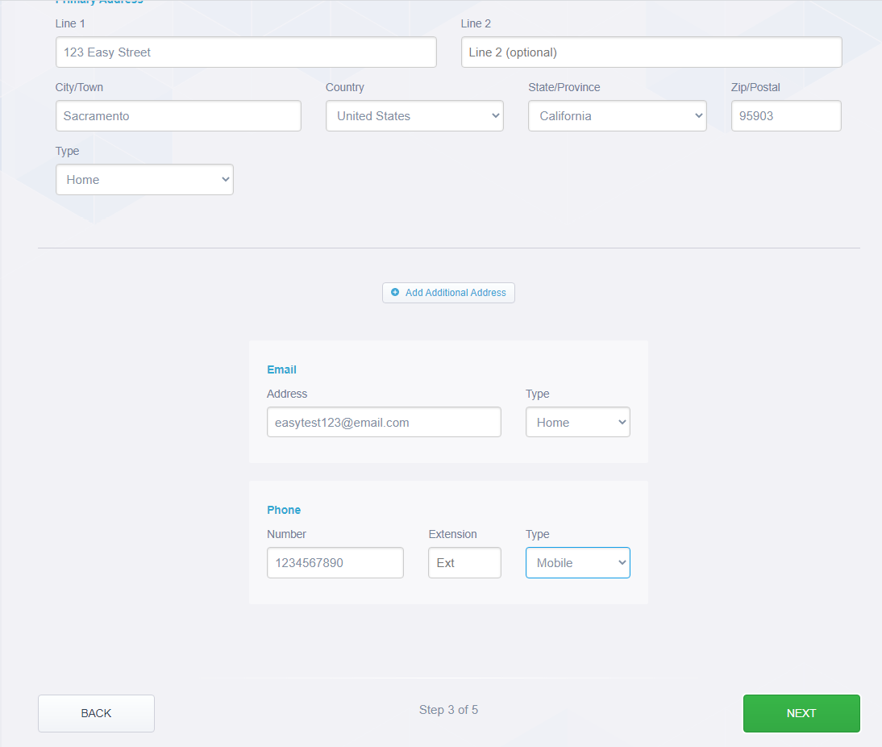
Pre-enrollment step 3
The address tab is used incase the individual loses their credential, or we need to make contact regarding their visit on the installation. Please ensure all addresses are the most current available.
Note: This is the visitor’s home address.

Slide 8
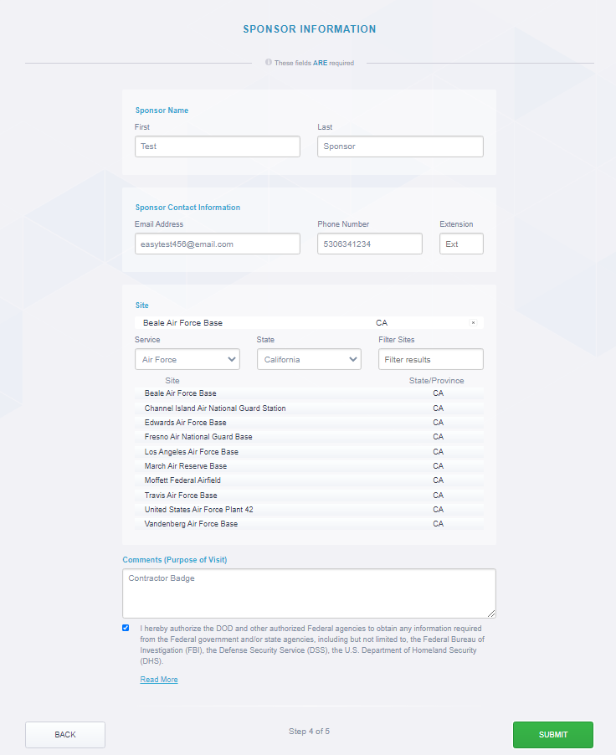
Pre-enrollment step 4
In the Service Drop Down, you will select “Air Force”. In the State Drop Down, you will select “California”. Then you will click on “Beale AFB” from the list provided below.

Slide 9
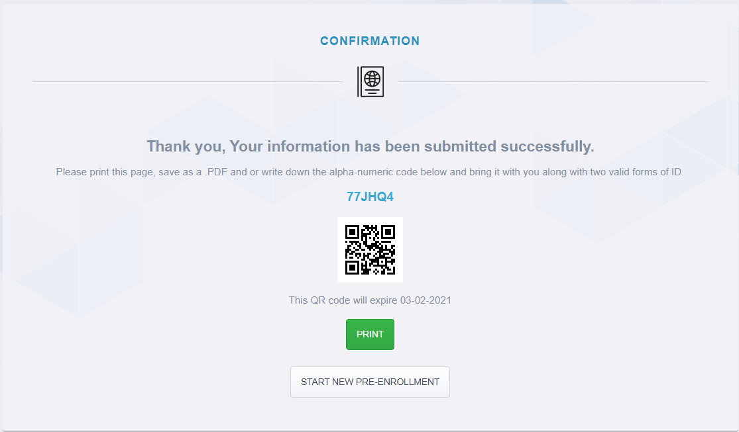
Confirmation Code
The easy 5 step process has now been completed.
The Sponsor will send the Alpha Numeric Code to
9SFS.VCC.RegistrationRequest@us.af.mil

Slide 10
Sponsor Steps
Step 1: Receive DBIDS confirmation code from previous slide.
Step 2: Receive photo of visitor’s driver's license.

Slide 11
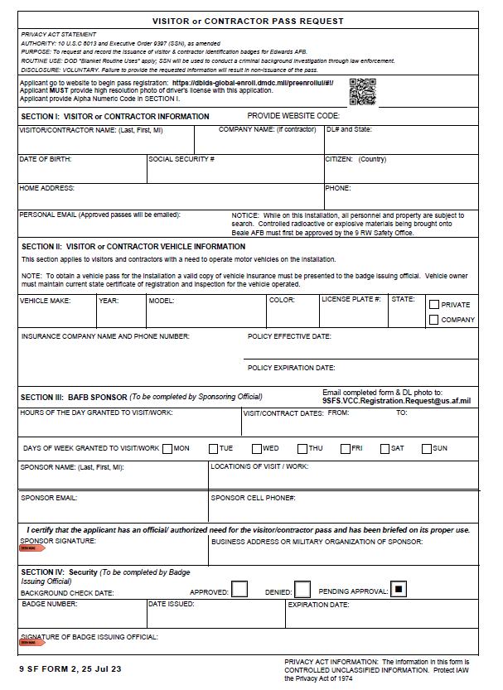
DBIDS Worksheet
Complete the following information in the worksheet.

Slide 12
Sponsor Steps cont’d
Step 4: email 9 SFS VCC org box 9SFS.VCC.RegistrationRequest@us.af.mil with the following
  DBIDS pre-enrollment code
  Photo of Visitors Driver’s License
  DBIDS Worksheet
Step 5: Wait for 9 SFS approval email

Slide 13
Frequently Asked Questions
Q1: As the sponsor, I submitted the QR code for my visitor to the 9 SFS Pass and Registration office. How long does it take for me to obtain an approval response from Security?
A1: Typically within 24-72 hours, but it could be as long as 5 days, depending on number of visitor requests being processed by 9 SFS Pass and Registration.
Q2: What types of visitors should use this new process?
A2: This process applies to all contractors or visitors without CACs or DOD issued credentials needing to obtain unescorted access to Beale AFB. This process is only open to U.S. Citizens or U.S. Persons in possession of a Permanent Resident card or VISA.
Q3: If a visitor or contractor is traveling to Beale AFB with me in the same car to a meeting, would DBIDS Pre-Enrollment be required?
A3: No, the Pre-enrollment process is not required; however, it could be utilized. If the visitor does not wish to use the pre-enrollment process they can obtain a visitors pass at the gate upon initial arrival.

Slide 14
Frequently Asked Questions Cont’d
Q4: For new employees who need access prior to getting a CAC, would this process be applicable to get them on the base until they can obtain a CAC?
A4: Yes, DBIDS Pre-Enrollment would apply. The best way to proceed is for a new employee to schedule a CAC appointment with DEERS as early as possible and then use DBIDS Pre-Enrollment to secure the new employee a visitor’s pass. This process should be used if there are extended wait times for a CAC appointment.
Q5: In the past, we have met our visitors at the Visitor Center and 9 SFS will conduct vetting and then a 1-30 day pass would be issued for the visitor. Can we continue to follow this process?
A5: Sponsors and visitors are welcome to meet at the Visitors Center adjacent to Wheatland Gate. Once there they will be vetted and issued a visitors pass for a duration between 1 and 30 days, dependent on the duration of their visit.

Slide 15
Frequently Asked Questions Cont’d
Q6: I’m retiring or having a special event. Can I plan this?
A6: Yes, using the Special Event EAL, and with a Group level O-6 or E-9’s approval. And send it to the 9SFS.EAL@us.af.mil. They would then be added to the Base Access List (BAL).
Q7: I have a foreign visitor coming, will this work?
A7: No, you must complete a Foreign Visitor EAL, please note that this are ran by multiple agencies and can take 10-14 duty days. And the send it to the 9SFS.EAL@us.af.mil. They would then be added the the BAL.
Q7: What are the turn around times or rules for the BAL?
    A8: BAL's requests that contain less than 15 individuals require 3 business days to complete. BAL's requests containing 15 individuals or more require 7 business days to complete. ALL fields need to be completed properly, NO EXCEPTIONS. SSN is used to positively identify individuals. Failure to identify individuals is automatic DENIAL to Beale AFB. Special Events are for 1 day only. And will be requested 7 business days prior.

